Slide 1

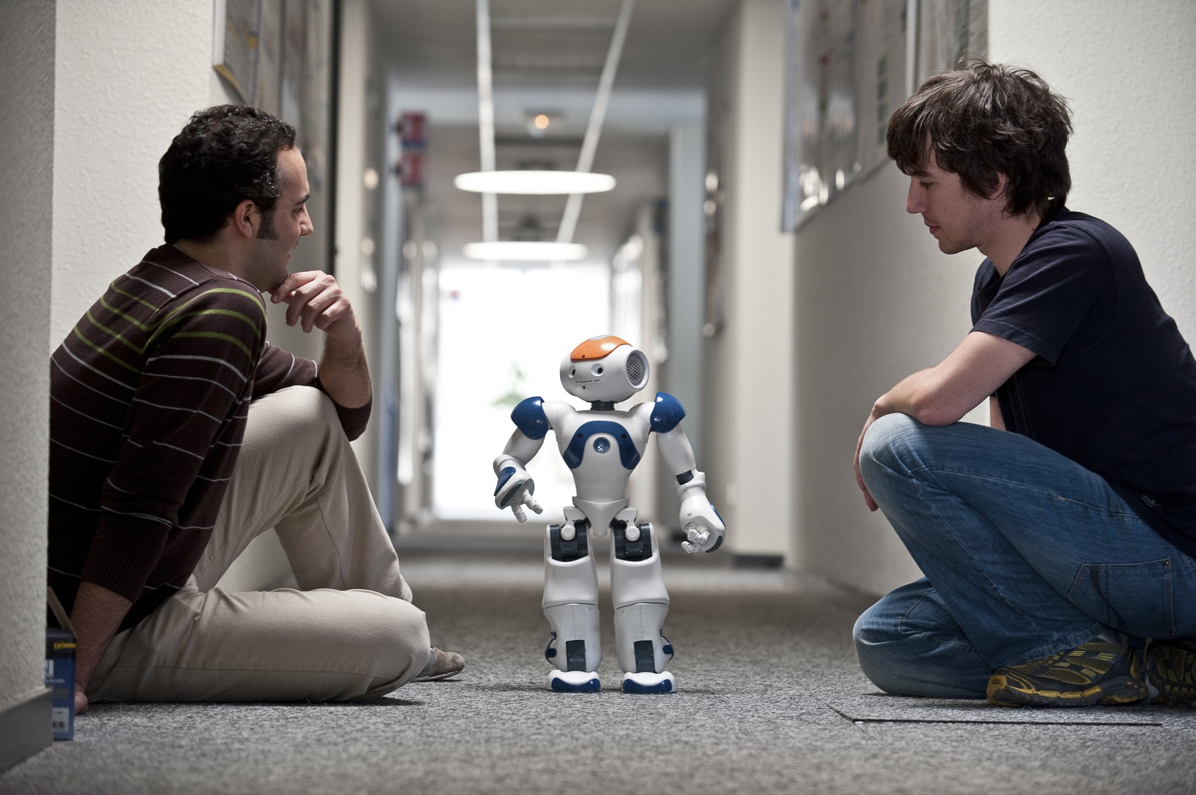
Context awareness in Human-Robot Interaction
Vishwanath Tarikere Sathyanarayana
Robotics Research Lab
Department of Computer Science
Technische Universität Kaiserslautern, Germany

Slide 2
Outline
Introduction
Importance of Context
Psychological Background
Types of Context
Approach
Applying awareness framework
Experiment
Context-Based HRI Framework
Conclusion

Slide 3
Introduction
Human-Human Interaction
Human-Robot Interaction
What is context?

Slide 4
Why context?
Best solution.
Intelligent behaviour.
Situation understanding.
Example: Time context, Situation context.

Slide 5
Psychological background
Classification of context
The spatio context: covers contemporary parameters.
The temporal context:
Intellectual: Background Knowledge.
Existential: Selective interest related to the notion of situation.

Slide 6
Types of Context
Location
Activity
Identity
Time
Social

Slide 7
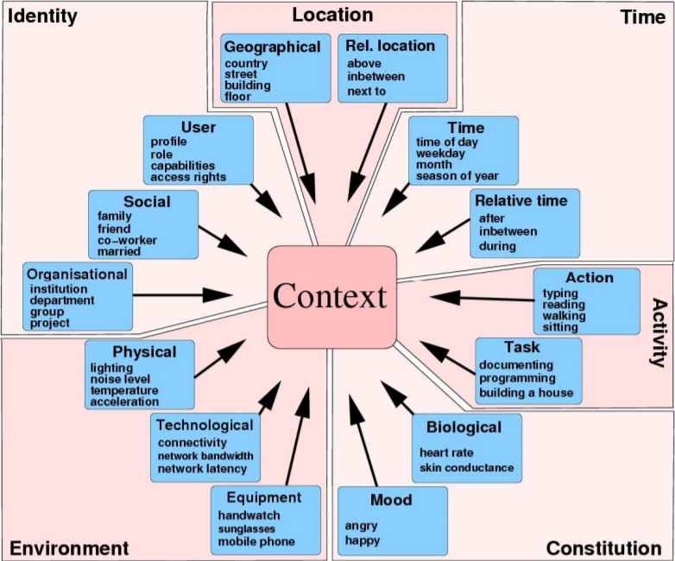

Slide 8
Approach
Computer-Supported Cooperative work
Enables computer systems to collaborate and coordinate a set of activities among group of individuals.
Groupware, Its different from normal software.
It equips them to understand the activities and identities of every participant.

Slide 9
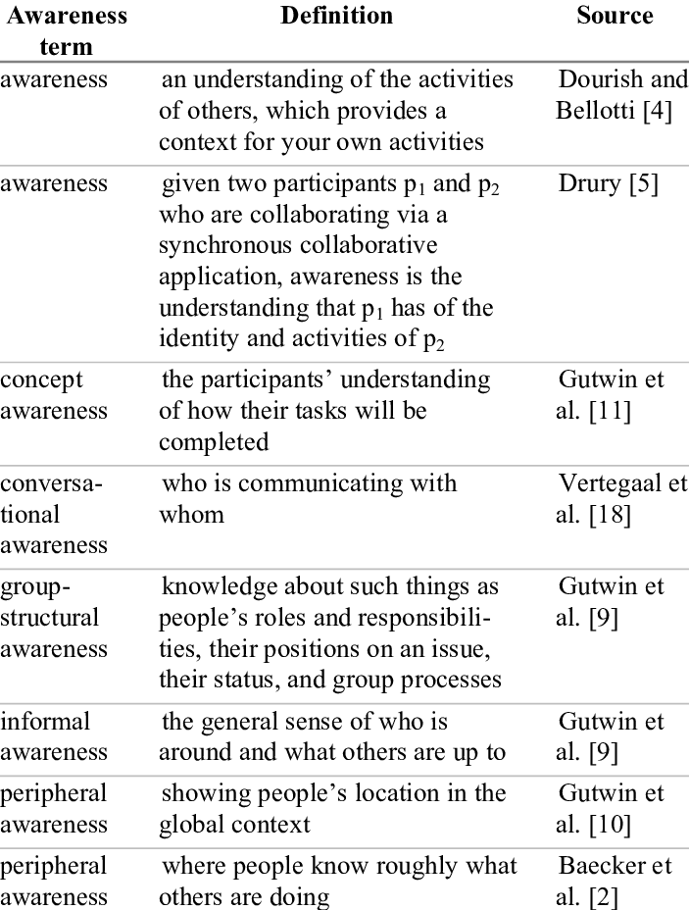
Definitions of awareness in the CSCW

Slide 10
CSCW(Cont..)
Participants in CSCW applications are mainly humans, Where as in HRI, it could be either robots or humans constituting one or many numbers.
Robots coordinate in real time task, But less cognitive ability compare to humans.
Renders various combinations that includes single and multiple humans and robots.
The most elementary combination(base case): Single robot interacts with the single person.
The greater or lesser awareness is required depending upon the level of autonomy.

Slide 11
Definite cases
This is mainly due to the non-symmetrical nature of HRI awareness.
Human-Robot
Robot-Human
Human-Human
Robot-Robot
Humans’ overall mission awareness: Understanding of the overall goals of the joint human-robot activities and the measurement of the moment against the goals.
Sufficient HRI awareness is required to ensure smoothly functioning in Human-Robot coordination on a shared task.
Insufficient HRI awareness causes HRI awareness violation.

Slide 12
Applying the context awareness framework
Search and rescue domain-Safety-critical situation.
Methodology
Competition uses rules and scoring algorithm.
Address several issues that rise in real urban search and rescue situation.
Percentage of victims, number of unique victims and accuracy of victim reporting.
Penalties for bumping into victims or the environment.
Operators and robots were videotaped.
The resulting data consisted chiefly of videotapes, competition scoring sheets, maps of robot paths.
Developed a coding scheme to capture the number and duration of occurrences of various types of activities: header and primitive codes.

Slide 13
Overview of User Interfaces
Team A
Team A developed a heterogeneous robot team of five robots, one iRobot ATRV-Mini and four Sony AIBOs.
All robots were teleoperated serially.
The four AIBOs were mounted on a rack at the back of the ATRV-Mini
Team A developed two custom user interfaces, one for the ATRV-Mini and another for the AIBOs.
The user interface for the ATRV-Mini had multiple windows: a video image taken by the robot, a map constructed by the robot using the SICK laser scanner and odometry.
The operator drove the robot using keys on the keyboard to move forward, backward, right and left.
The user interface for the AIBOs had a window with the video image sent from the robot. The operator controlled the robots using buttons on the GUI.

Slide 14
Team B
Can use in hazardous environment.
The control of the robot selected from teleoperated, safe, shared, and autonomous.
The interface is developed and displayed on the screen.
Upper left: Video feed from the robot.
Lower left: Sensor information such as battery level, heading and tilt of the robot.
The robot was controlled through a combination of joystick and touch screen.

Slide 15
Team C
Two identical robots.
The communication between the user interface and robot was achieved with a RF modem.
A custom interface was developed for a sophisticated user.
Team C started their run 1 using a graphical user interface, but switched back to a text-based interface when there were command latency problems with the GUI.
The text-based interface had 14 text windows and 4 graphic windows, half for each of the robots.
The 7 text windows were for the following: the IPC server, the navigation module, the vision module, the mapping module, the navigation command line, for starting and monitoring the visual display, and for starting and monitoring the map display.
The two graphic windows were for displaying the camera image and the map image.

Slide 16
Team D
Developed two custom built robots, one wheeled and one tracked, with the same sensing and operating capabilities.
A wireless modem was used to communicate between the user interface and the robots.
Developed a custom user interface on two screens. One monitor displayed the video feed from the robot that was currently being operated.
The other monitor had a pre-entered map of the arena, on which the operator would place marks to represent the locations of victims that were found.

Slide 17
Results
Critical incidents and other results in term of five different types of HRI awareness.
Critical Incidents:
AIBS were particularly useful for getting into small spaces but that were difficult for the ATRV-Mini maneuver in.
AIBO fell off, the become trapped under fallen Plexiglas.
During run 1, the Team B operator moved the robot’s video camera off-center to perform a victim identification.
After the victim identification, he let the robot maneuver itself out of the tight area in shared mode, forgetting to re-center the camera. When he switched back to safe mode, he thought his camera was pointing forward, when it was really pointed 90 degrees to the left.
This resulted in the operator accidentally driving the robot out of the arena into the crowd, and bumping into a wall trying to get back into the arena.

Slide 18
Critical Incidents(cont..)
During run 3, Team B’s operator did not have good visibility into the areas behind the robot, making it difficult for him to maneuver it out of narrow spaces.
Team C started a run with GUI, but within two min, operator determines too much lag between command issuance and response.
As a result, he shut down the GUI windows and brought up nine windows that formed an earlier version of the interface.
It took a little time to shutdown GUI and bring up all the windows for the earlier version.

Slide 19
Analysis using HRI awareness framework
Types of HRI awareness: H-H, H-R, R-R, R-H.
No Human-human and Robot-Robot interaction.
Many instances human-robot violations were noted.
Regarding location and surroundings.
Example, Team B during run 3 and Team D overall , there was not enough awareness of the area immediately behind the robot, causing the robot to bump obstacles when backing up or maneuvering the robots in small spaces.
The operator was not aware of the robot’s size in relationship to the space through which the robot was attempting to navigate.

Slide 20
Context-Based HRI Framework
The main objective of this framework :
Creation of framework.
Addresses the problem of incorporating contextual information.

Slide 21
A. Generic Architecture
LAAS developed Generic architecture.
Integration of contextual information.
Used in DALA, an iRobot ATRV.

Slide 22
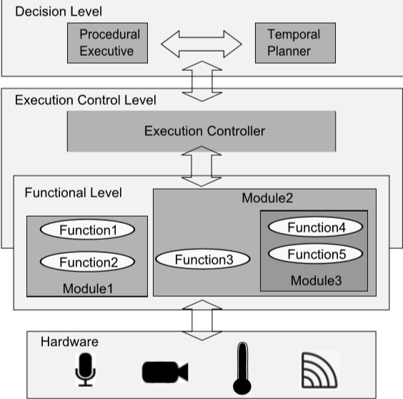
Generic Architecture (Cont..)
The architecture comprises four layers as shown below
Fig: Generic architecture

Slide 23
B. Extended existing architecture
The Context-based Human-Robot Interaction Framework (CB-HRI) is conceptually an extension of an existing/generic architecture.
This framework acts as a middle ware to integrate contextual information in the overall system and control the workflow related with human-robot interaction.

Slide 24
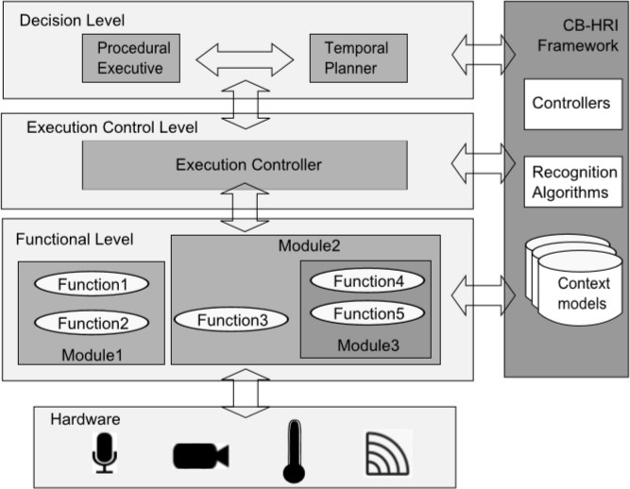
Extended existing architecture(Cont..)
Fig: Context-based Human-Robot Interaction Framework

Slide 25
Context verification process
The context is described as the output of the transformation of raw sensor data into a useful data or information.
The context is obtained through classification of sensor data based on the restriction or guidelines for the particular situation.
Dynamic process.

Slide 26
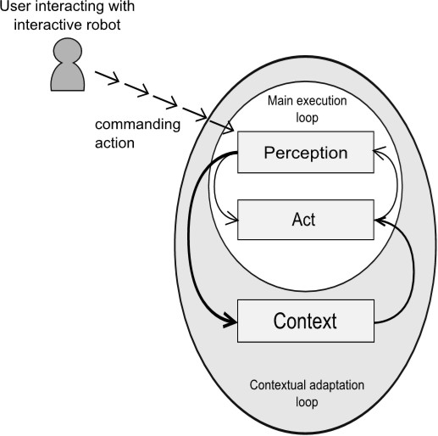
Context verification process(cont..)
Fig: Context verification process

Slide 27
Conclusion
All critical incidents were due to some type of awareness violation.
Due to a lack of human-robot awareness of location and surroundings.
HRI awareness is a useful concept for evaluating human-robot interfaces.
The importance of addressing contextual information in the human-robot interaction process.
Aims to provide a solution to the problem of integrating contextual information in the interaction processes.

Slide 28


Slide 29
Thank You.

